Slide 1
DATA LINK LAYER
UNIT-II

Slide 2
Data link layer:
Data-Link Layer has responsibility of transferring frames from one node to adjacent node over a link
DATA LINK LAYER DESIGN ISSUES:
  Data link layer has a number of specific functions to carry out. These functions include
    Provides a well-defined service interface to the network layer.
    Determines how the bits of the physical layer are grouped into frames (framing).
    Deals with transmission errors (CRC and ARQ).
      Systems which automatically request the retransmission of missing packets or packets with errors are called Automatic Repeat reQuest (ARQ)
    Regulates the flow of frames.

Slide 3
Data link layer-Introduction
The data link layer takes the packets it gets from the network layer and encapsulates them into frames for transmission .
Each frame contains frame header ,a payload field for holding the packet ,and a frame trailer
Sending Machine
Receiving Machine
packet
packet
Header payload field Trailer
Header payload field Trailer
Relationship between packets and frames

Slide 4
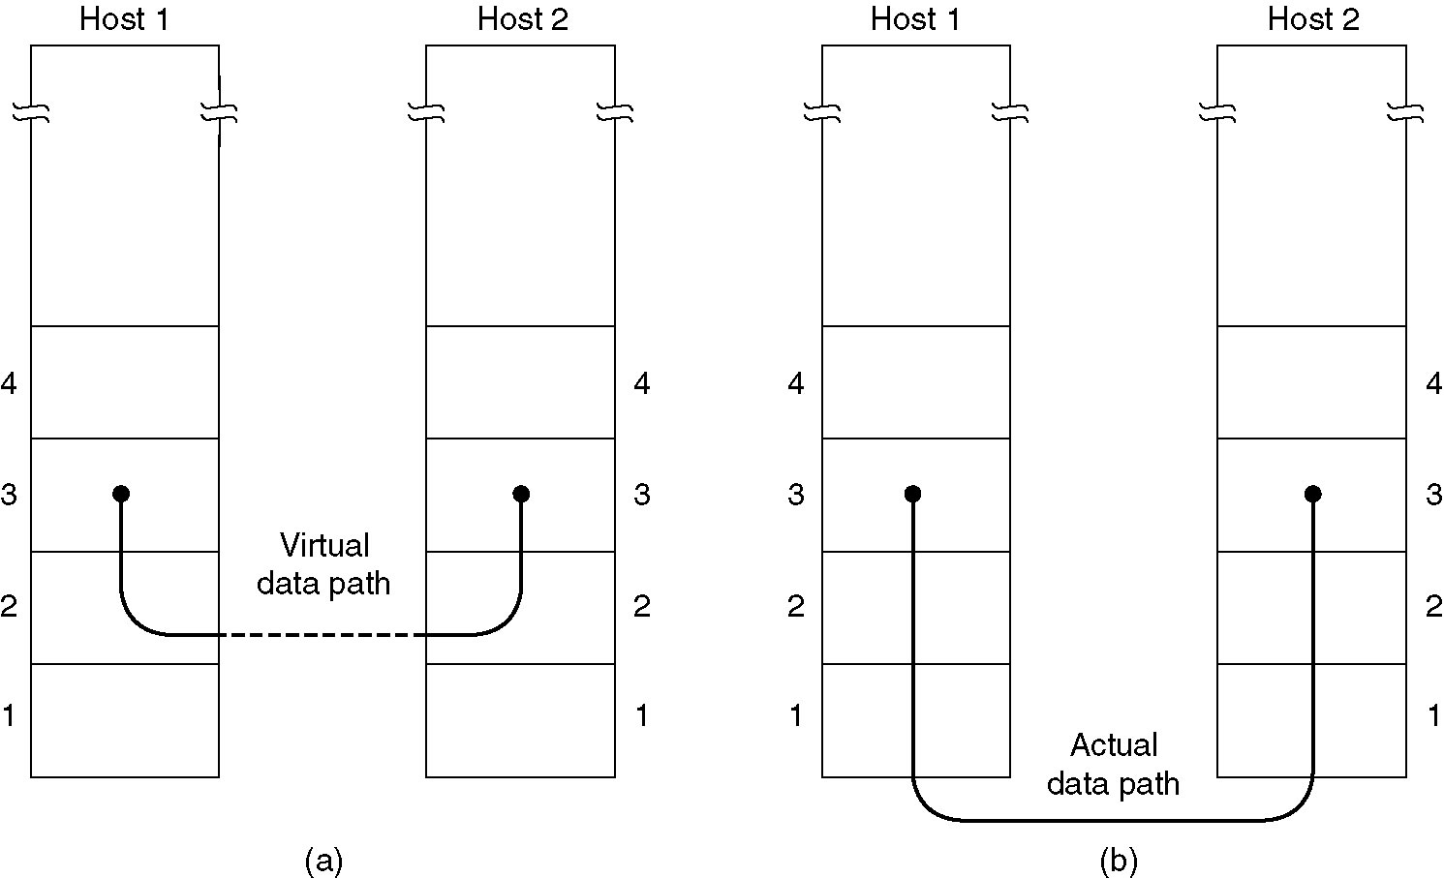
Data link layer-Introduction
Services Provided to the Network layer:
  The function of the data link layer is to provide services to the network layer
  The principal service is transferring data from the network layer on the source machine to the network layer on the destination machine.
(a) Virtual Communication (b)Actual communication

Slide 5
Types of services provided to the Network Layer
Unacknowledged Connectionless service
Acknowledged Connectionless service
Acknowledged Connection-Oriented service

Slide 6
Unacknowledged Connectionless service:
It consists of having the source machine send independent frames to the destination machine without having the destination acknowledge them.
No connection is established beforehand or released afterward
If a frame is lost due to noise on the line, no attempt is made to recover it in the data link layer.
Appropriate for voice, where delay is worse than bad data.
Most of the LANs use unacknowledged connection less service in the data link layer

Slide 7
Acknowledged Connectionless service
  when this service is offered, there are still no logical connections used, but each frame sent is individually acknowledged.
  In this way ,the sender knows whether a frame has arrived correctly.
  If it has not arrived within a specified time interval it can be sent again.
  This service is used over unreliable channels ,such as wireless systems.

Slide 8
Acknowledged Connection-Oriented service
  The most sophisticated service the data link layer can provide to the network layer is connection-oriented service.
  The source and destination machines establish a connection before any data are transferred
  Each frame sent over the connection is numbered ,and the data link layer guarantees that each frame is received exactly once and that all frames are received in the right order
  When connection oriented service is used ,transfers go through three distinct phases.
      1) Connection established
      2) Data transferred
      3) connection Released

Slide 9
Transport layer-End to End
ACK/NAK
1
2
3
4
5
Data
Data
Data
Data
Data link layer-Hop by Hop
Data
Data
Data
Data
1
2
3
4
5
ACK/NAK
ACK/NAK
ACK/NAK
ACK/NAK

Slide 10
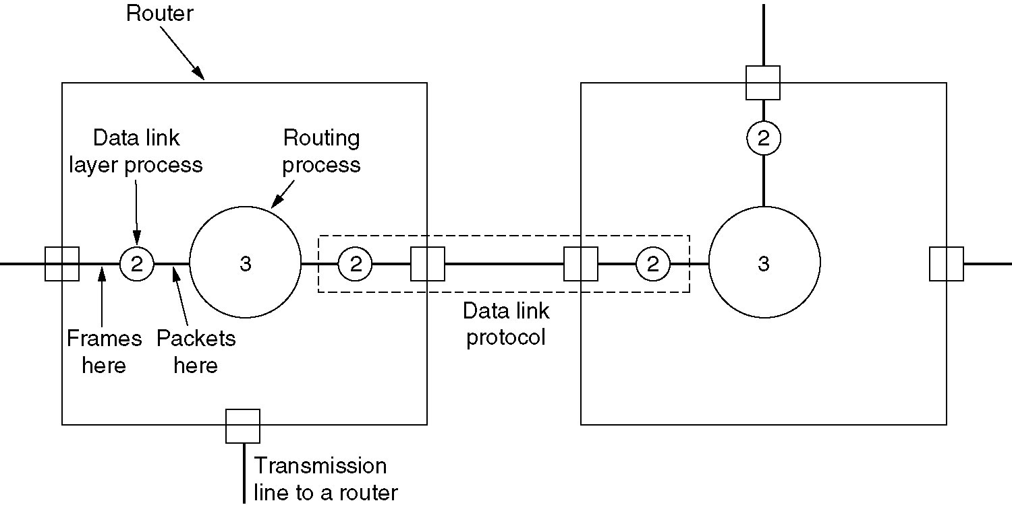
Services Provided to Network Layer
Placement of the Data link protocol

Slide 11
Framing:
In order to provide service to the network layer the data link layer must use the service provided to it by the physical layer.
Physical layer is used to accept the raw bit stream and attempt to deliver it to the destination
The bit stream is not guaranteed to be error free
The number of bits received may be less than ,equal to ,or more than the number of bits transmitted, and they may have different values
It is up to the data link layer to detect and if necessary ,correct errors.
The usual approach is for the data link layer to break the bit stream up into discrete frames and compute the checksum for each frame.

Slide 12
Framing:
When a frame arrives at the destination ,the checksum is recomputed.
If the newly computed checksum is different from the one contained in the frame, the data link layer knows that an error has occurred and take steps to deal with it.
  e.g., discarding the bad frame and possibly also sending back an error report
Breaking the bit stream up into frames is more difficult than it at first appears, One way to achieve this framing is to insert time gaps between frames, much like the spaces between words in ordinary text.

Slide 13
Methods:
1) character count
2) Flag bytes with byte stuffing
3) starting and ending flags, with bit stuffing
4)Physical Layer Coding Violations

Slide 14
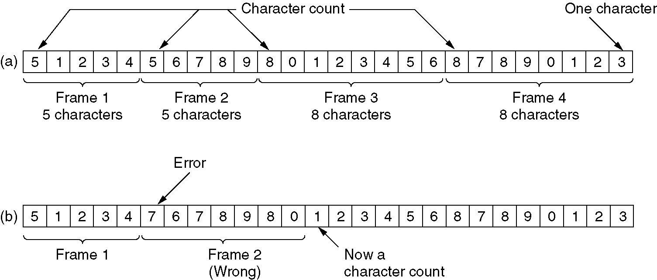
Character count:
A character stream a) with out errors b) with one error
The first framing method uses a field in the header to specify the number of characters in the frame.
When the data link layer in the destination sees the character count ,it knows how many characters follow and hence where the end of the frame is.

Slide 15
Character count:
The trouble with this algorithm is that the count can be garbled by a transmission error.
For example, if the character count of 5 in the second frame becomes a 7,the destination will get out of synchronization and will be unable to locate the start of the next frame.
Disadvantages:
  The count can be garbled by the transmission error
  Resynchronization is not possible. Even if with checksum, the receiver knows that the frame is bad there is no way to tell where the next frame starts.
  Asking for retransmission doesn’t help either because the start of the retransmitted frame is not known
  No longer used

Slide 16
The second transmission method gets around the problem of Resynchronization called character stuffing.
Most protocols used the same byte ,called flag byte, as both the starting and ending delimiter as FLAG.
Two consecutive flag bytes indicate the end of one frame and start of the next one.

Slide 17
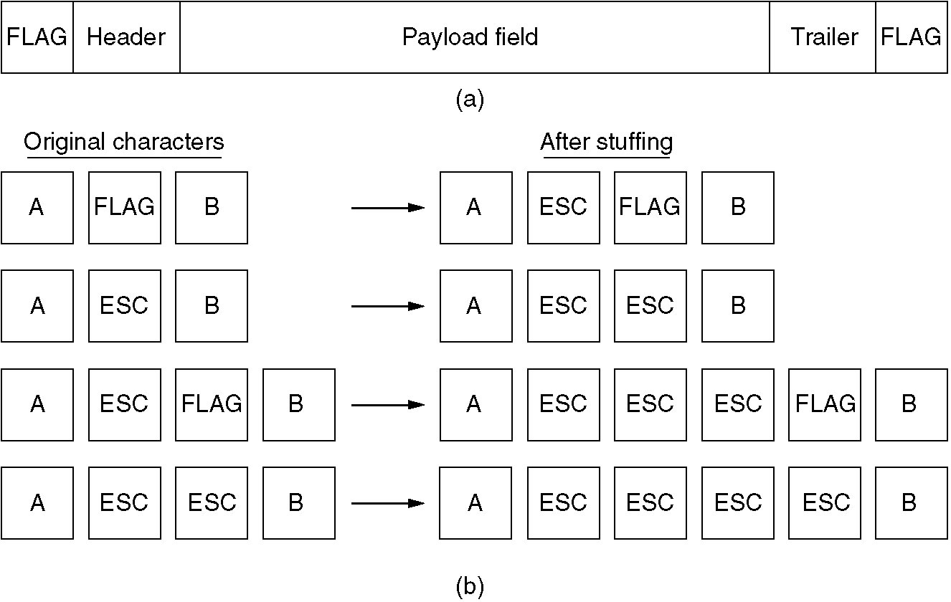
Framing: Character stuffing – newer protocols
  Frame starts / ends with same char: FLAG

Slide 18
starting and ending flags, with bit stuffing
This new technique allows data frames to contain an arbitrary number of bits and allow character codes with an arbitrary number of bits per character.
Each frame begins and ends with a special bit pattern,01111110 called a flag byte.
whenever the senders data link layer encounters six consecutive ones in the data , it automatically stuffs a 0 bit into the outgoing bit stream.
whenever the receiver sees five consecutive incoming 1 bits, followed by a 0 bit ,it automatically destuffs (i.e deletes) the 0 bit.
If the flag pattern 01111110,this flag is transmitted as 011111010 but stored in the receiver memory as 01111110.

Slide 19
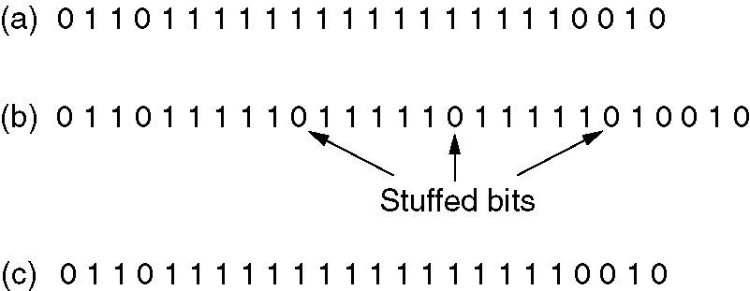
starting and ending flags, with bit stuffing
Bit stuffing
(a) The original data.
(b) The data as they appear on the line.
(c) The data as they are stored in receiver’s memory after destuffing.

Slide 20
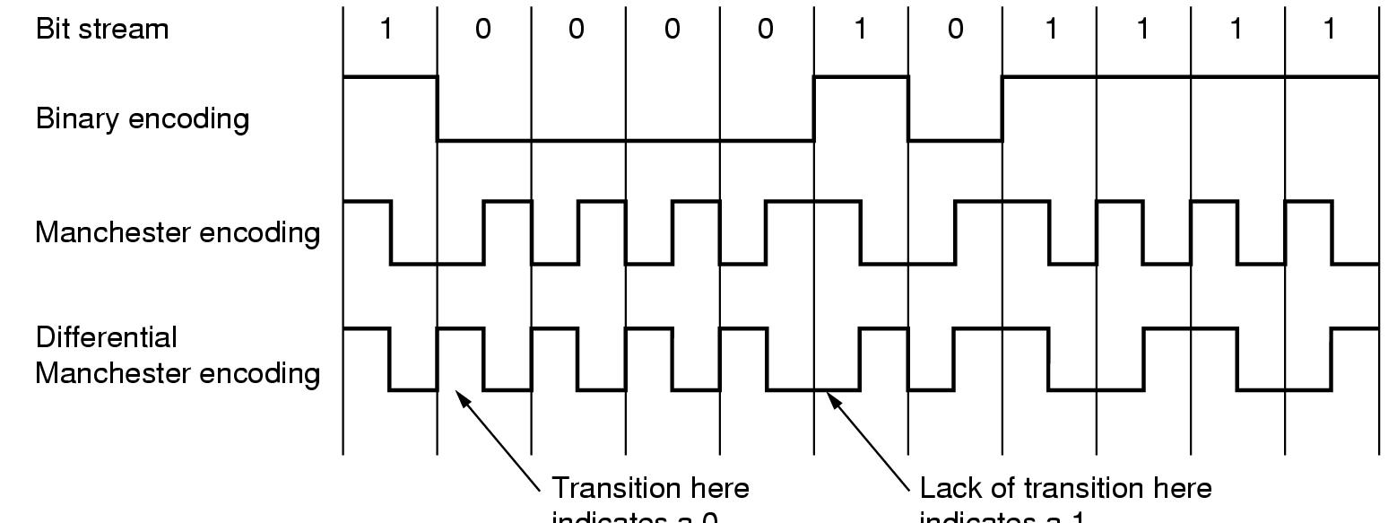
Framing: Coding violation
  Redundancy in the encoding on medium is required
  e.g. Manchester encoding: transition in the middle of a slot
  Use no transition in a slot (= coding violation) as start of frame
violation

Slide 21
Error Control:
Next problem: How to make sure all frames are eventually delivered to the network layer at the destination, and in the proper order.
The usual way to ensure reliable delivery is to provide the sender with some feedback about what is happening at the other end of the line.
The protocol calls for the receiver to send back special control frames bearing positive and negative acknowledgements about the incoming frames

Slide 22
Error Control:
If the sender receives a positive acknowledgement about a frame ,it knows the frame has arrived safely.
on the other hand, a negative acknowledgement means that something has gone wrong, and the frame must be transmitted again.
An additional complication comes from hardware troubles.
Managing the Timers and sequence numbers so as to ensure that each frame is ultimately passed to the network layer at the destination exactly once.

Slide 23
Error Control:
Maintaining Timers for Error Control: When a sender transmits a frame, it generally also starts a timer .
The timer is set to expire after an interval long enough for the frame to reach the destination, be processed there ,and have the acknowledgement to propagate back to the sender.
Normally, the frame will be correctly received and the acknowledgement will get back before the timer runs out ,in which case the timer will be cancelled.
However, if either the frame or the acknowledgement is lost ,the timer will go off ,alerting the sender to a potential problem .the obvious solution is to just transmit the frame again.
Sequence number is used to recognize the duplicate packet.

Slide 24
Flow control:
A sender that systematically wants to transmit frames faster than the receiver can accept them..
When the sender is running on a fast (or lightly loaded) computer and the receiver is running on a slow (or heavily loaded machine)
The sender keeps pumping the frames out at a higher rate until the receiver is completely swamped.
Even if the transmission is error free ,at a certain point the receiver will simply be unable to handle the frames as they arrive and will start to lose someone
To prevent this situation Feedback- based flow control & Rate-based flow control mechanisms are used.
Feedback- based flow control ,the receiver sends back information to the sender giving it permission to send more data .
Rate based :Has built in mechanism with out feedback.

Slide 25
Error Detection and correction:
In some cases it is sufficient to detect an error and in some, it requires the errors to be corrected also.
For e.g.
  On a reliable medium : Error Detection is sufficient where the error rate is low and asking for retransmission after Error Detection would work efficiently
  In contrast, on an unreliable medium : Retransmission after Error Detection may result in another error and still another and so on. Hence Error Correction is desirable.

Slide 26
Error Detection and Correction
Types of Errors
Error-Correcting Codes
Error-Detecting Codes

Slide 27
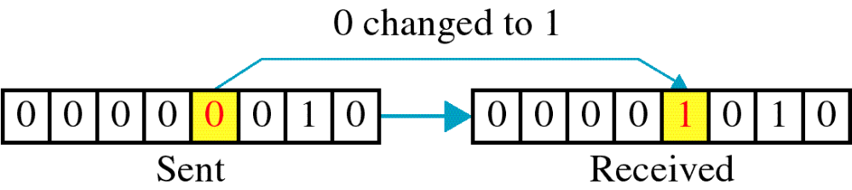
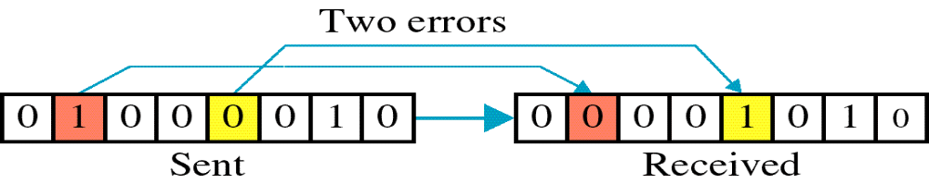
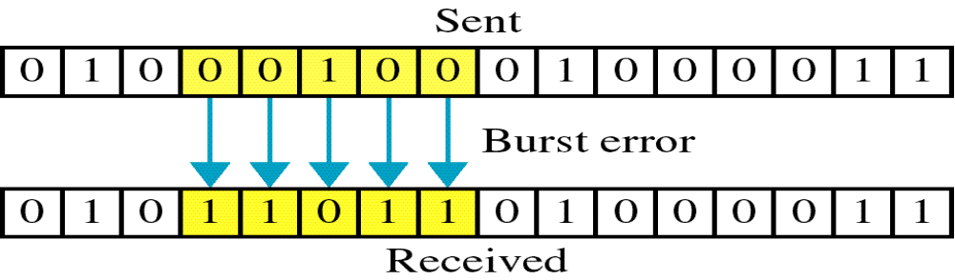
Types of Errors
Single-Bit Error:
Burst Error:
(a)
(b)

Slide 28
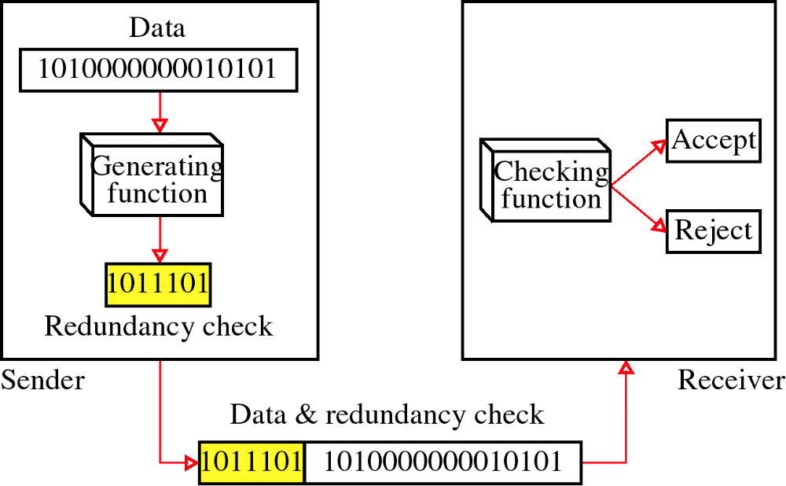
Redundancy
→ All error detection/correction methods are based on redundancy

Slide 29
Error detecting Codes:
Polynomial code or CRC( Cyclic Redundancy Check )
CRCs are among the best checksums available to detect errors in communications transmissions
polynomial codes are based upon treating bit strings as representations of polynomials with coefficients of 0 and 1 only.
A k-bit frame is regarded as the coefficient list for a polynomial with K terms ,ranging from X^{k-1} to x⁰. such a polynomial is said to be of degree k-1.
The higher order (left-most) bit is the coefficient of x^{k-1} .the next bit coefficient of x^{k-2}
Ex: 110001 has 6 bits. It represents a six-term polynomial with coefficients 1100001
    110001 : x⁵+x⁴+1

Slide 30
Error detecting Codes:
When the polynomial code method is employed ,the sender and receiver must agree upon a generator polynomial G(x) .
In advance both higher and lower order bits of generator must be 1.
To compute the check sum for some frame with m bits ,corresponding to the polynomial M(x), the frame must be longer than the generator polynomial.
The idea is to append a checksum to the end of the frame in such a way that the polynomial represented by the check summed frame is divisible by G(x).
When the receiver gets the check summed frame, it tries dividing it by G(x). If there is a remainder ,there has been a transmission error

Slide 31
Algorithm:
Let r be the degree of G(x)
Append r zero bits to the low-order end of the frame ,so it now contains m+r bits and corresponds to the polynomial x^{r}M(x).
Divide the bit string corresponding to G(x) in to the bit string corresponding to X^{r}M(x) using modulo 2 division.
subtract the remainder (which is always r or fewer bits ) from the bit string correspond to x^{r}M(x) using modulo 2 subtraction.
the result is the check summed frame to be transmitted .call its polynomial T(x).

Slide 32

Calculation of the polynomial code checksum:
Frame: 1001 Generator : 1011

Slide 33

Division in the CRC decoder for two cases:

Slide 34
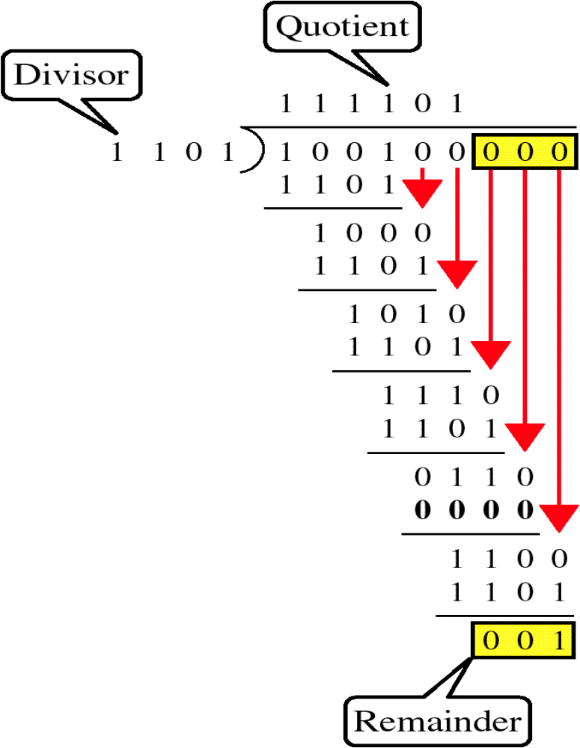
CRC
Example:
G
M
Message transmitted: T = 100100001

Slide 35
The modulo-2 division process is defined as follows:
Call the uppermost c+1 bits of the message the remainder
Beginning with the most significant bit in the original message and for each bit position that follows, look at the c+1 bit remainder:
  If the most significant bit of the remainder is a one, the divisor is said to divide into it. If that happens (just as in any other long division) it is necessary to indicate a successful division in the appropriate bit position in the quotient and to compute the new remainder. In the case of modulo-2 binary division, we simply:
    Set the appropriate bit in the quotient to a one, and
    XOR the remainder with the divisor and store the result back into the remainder
  Otherwise (if the first bit is not a one):
    Set the appropriate bit in the quotient to a zero, and
    XOR the remainder with zero (no effect)
  Left-shift the remainder, shifting in the next bit of the message. The bit that's shifted out will always be a zero, so no information is lost.
The final value of the remainder is the CRC of the given message.

Slide 36
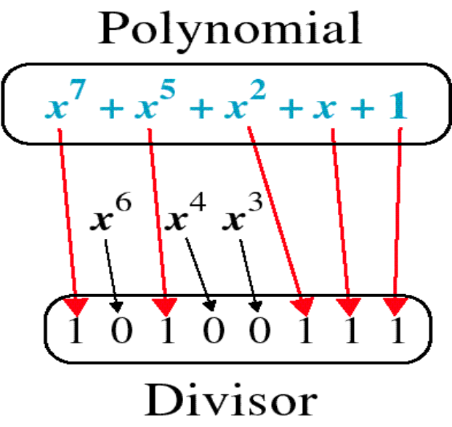
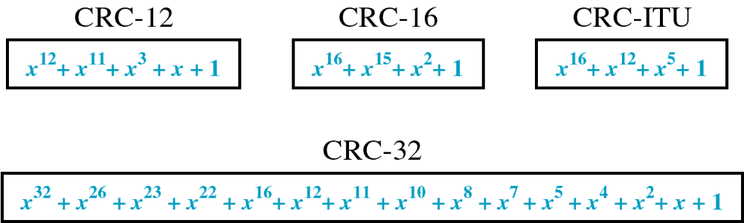
CRC
Why polynomials?
Standard polynomials:
(IEEE 802)

Slide 37
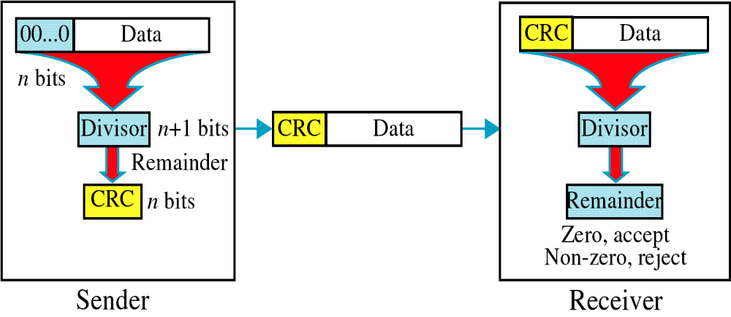
CRC
r bits
r+1 bits
r bits

Slide 38
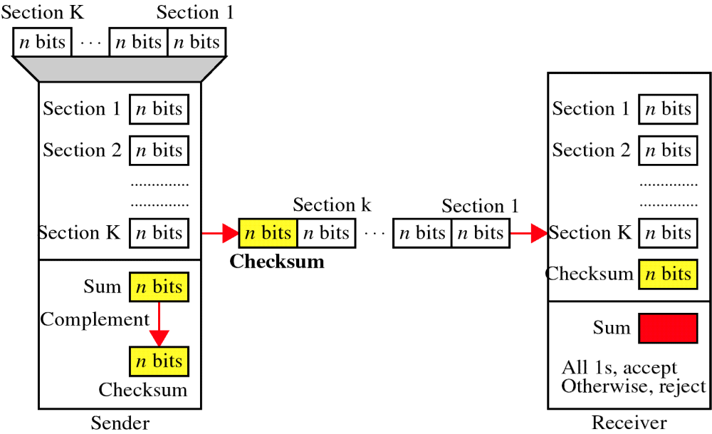
Checksum

Slide 39
At the sender
The unit is divided into k sections, each of n bits.
All sections are added together using one’s complement to get the sum.
The sum is complemented and becomes the checksum.
The checksum is sent with the data

Slide 40
Performance
The checksum detects all errors involving an odd number of bits.
It detects most errors involving an even number of bits.
If one or more bits of a segment are damaged and the corresponding bit or bits of opposite value in a second segment are also damaged, the sums of those columns will not change and the receiver will not detect a problem.

Slide 41
At the receiver
The unit is divided into k sections, each of n bits.
All sections are added together using one’s complement to get the sum.
The sum is complemented.
If the result is zero, the data are accepted: otherwise, they are rejected.

Slide 42
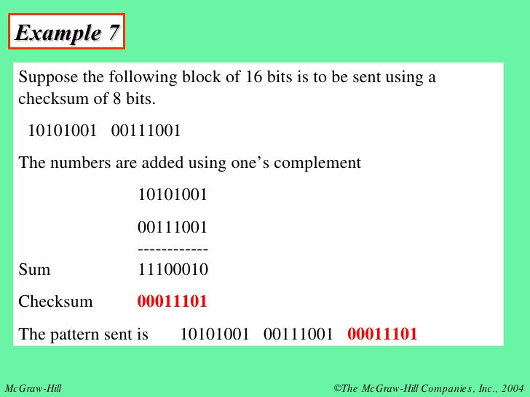
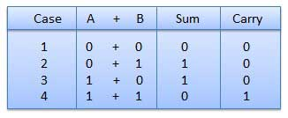

Slide 43
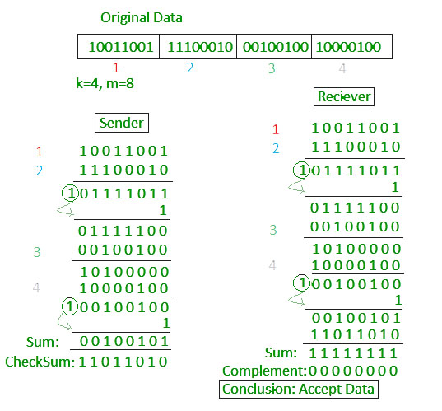

Slide 44
Error Detection:
Parity Check
Simple Parity check :
Blocks of data from the source are subjected to a check bit or parity bit generator form, where a parity of 1 is added to the block if it contains odd number of 1’s and 0 is added if it contains even number of 1’s
This scheme makes the total number of 1’s even, that is why it is called even parity checking.

Slide 45
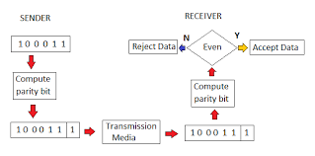

Slide 46
Two Dimensional Parity check :
Parity check bits are calculated for each row, which is equivalent to a simple parity check bit.
Parity Check bits are also calculated for all columns, then both are sent along with the data.
At receiving end these are compared with the parity bits calculated on the received data

Slide 47
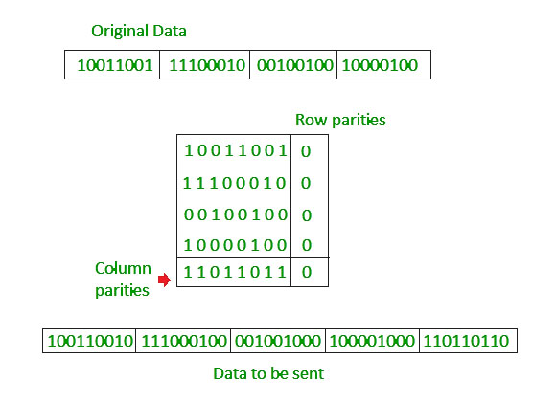

Slide 48
Error correcting codes:
A frame consists of m data (i.e,message ) bits and r redundant, or check bits.
Let the total length be n (i.e., n=m+r).an n-bit unit containing data and check bits is often referred to as an n-bit codeword.
Given any two code words ,say,10001001 and 10110001,it is possible to define how many bits differ .In this case 3 bits differ. To determine how many bits differ ,just EXCLUSIVE OR the two code words ,and count the number of 1 bits in the result. The number of bit positions in which two code words differ is called the Hamming distance.
Its significance is that if two code words are a hamming distance d a apart, it will require d single-bit errors to convert one into another.

Slide 49
Hamming Distance
The Hamming distance between two words of same size is the no.of differences between corresponding bits.
The Hamming distance can be found if we apply XOR operation on the two words and count no.of 1’s in the result.
d(000,011) is 2 because (000)XOR(011)=011(two 1s)
When a code word is corrupted during transmission, the hamming distance between sent and received code words is the number of bits affected by the error.
For e.g. if the codeword 00000 is sent and 01101 is received, 3 bits are in error and the Hamming distance between the two is d(00000,01101)=3.

Slide 50
Error correcting codes:
Minimum distance for Error Detection…
Let us find minimum distance in a code if we want to be able to detect upto s errors.
If s errors occur during transmission, the Hamming distance between the sent codeword and received codeword is s.
If our code is to detect up to s errors, the minimum distance between valid code words be s + 1, so that the received codeword does not match a valid codeword.
In other words, if the minimum distance between all valid code words is s + 1, the received codeword cannot be erroneously mistaken for another codeword.

Slide 51
Error correcting codes:
The distances are not enough(s+1) for the receiver to accept it as valid. The error will be detected.
A code with dmin=s+1 may be able to detect more than s errors in some special cases, only s or fewer errors are guaranteed to be detected.
To guarantee the detection of up to s errors in all cases, the minimum Hamming distance in a block code must be dmin=s+1.
A code scheme has dmin=4.What is error detection and correction capability of this scheme?
This scheme guarantees detection of upto three errors, but can correct up to one error

Slide 52
Error correcting codes:
Forward Error Correction: FEC is the only error correction scheme that actually detects and corrects transmission errors at the receive end with out calling for retransmission.
  Ex: Hamming code
No of bits in hamming code is dependent on the no. of bits in the data character by using the relation.
    2^{n}>=m+n+1
    Where n=no. of hamming bits
    m= no. of bits in the data character
  Ex: For a 12-bit data stream of 101100010010,determine the hamming bits ,assume a single bit in error & prove how hamming code detects it.

Slide 53
Error correcting codes:
No. of bits in hamming code
2^{n}>=m+n+1
    Take n=4
    2⁴=16>=12+4+1
        16>=17
  Take n=5
    2⁵=32>=12+5+1=18
      32>=18 ---- 5 bits are required for hamming code.
      12 bits of data +5 bits of code=17 bits of data stream.

Slide 54
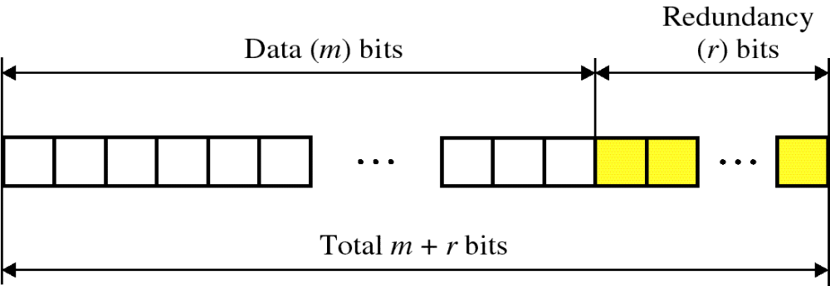
Error correcting codes:

Slide 55
Write the bit positions starting from 1 in binary form (1, 10, 11, 100, etc).
All the bit positions that are a power of 2 are marked as parity bits (1, 2, 4, 8, etc).
All the other bit positions are marked as data bits.
Each data bit is included in a unique set of parity bits, as determined its bit position in binary form.
a. Parity bit 1 covers all the bits positions whose binary representation includes a 1 in the least significant
position (1, 3, 5, 7, 9, 11, etc).
b. Parity bit 2 covers all the bits positions whose binary representation includes a 1 in the second position from
the least significant bit (2, 3, 6, 7, 10, 11, etc).
c. Parity bit 4 covers all the bits positions whose binary representation includes a 1 in the third position from
the least significant bit (4–7, 12–15, 20–23, etc).

Slide 56
d. Parity bit 8 covers all the bits positions whose binary representation includes a 1 in the fourth position from
the least significant bit bits (8–15, 24–31, 40–47, etc).
e. In general each parity bit covers all bits where the bitwise AND of the parity position and the bit position is
non-zero.
Since we check for even parity set a parity bit to 1 if the total number of ones in the positions it checks is
odd.
Set a parity bit to 0 if the total number of ones in the positions it checks is even

Slide 57
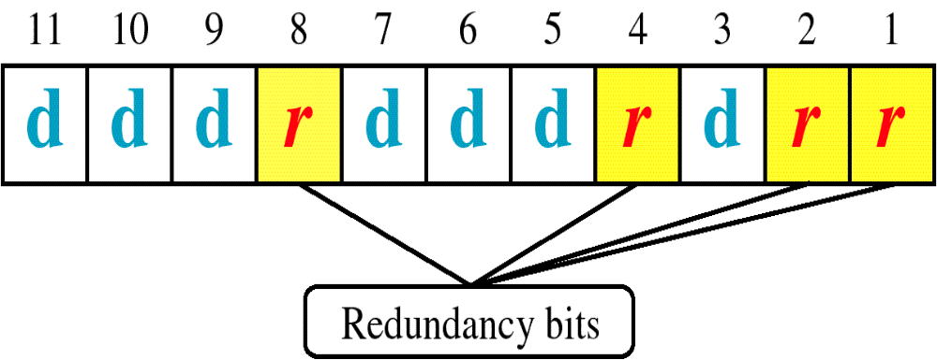
Hamming Code

Slide 58
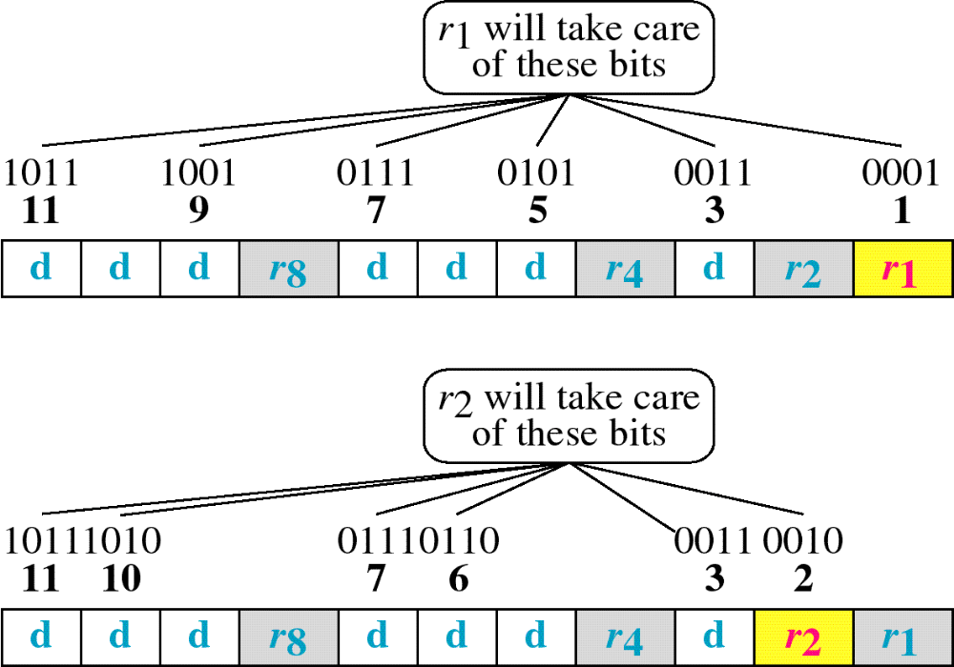
Hamming Code

Slide 59
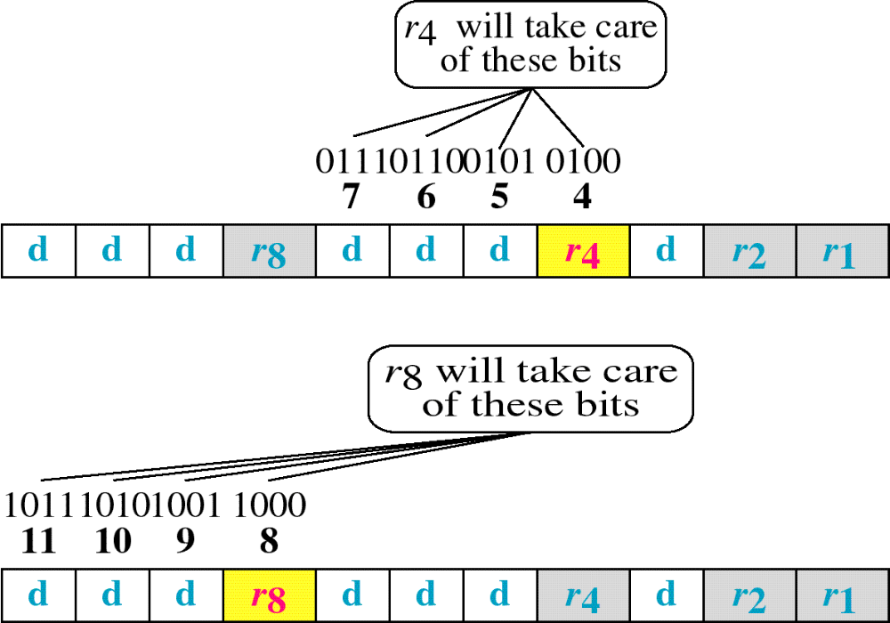
Hamming Code

Slide 60
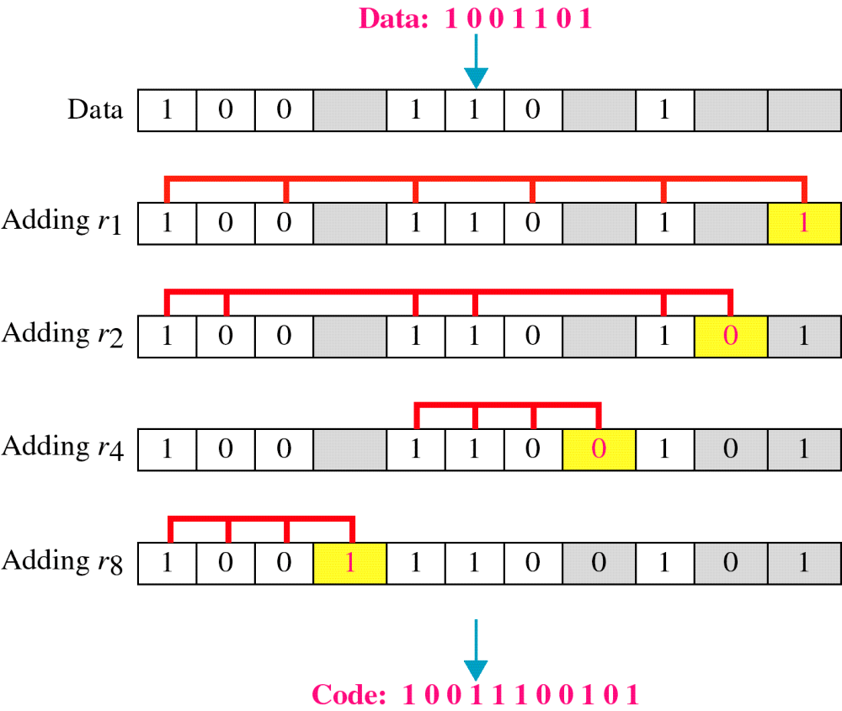
Example of Hamming Code

Slide 61
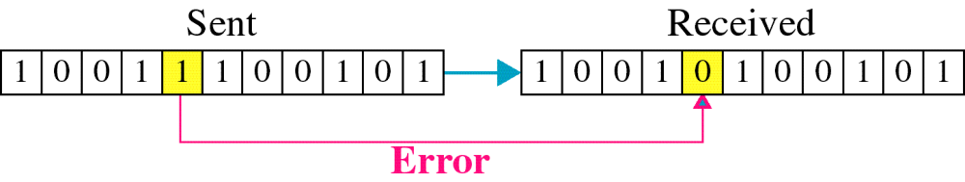
Single-bit error

Slide 62

Error
Detection

Slide 63
Hamming Code: Alternate method
consider the example m= 1101110
  2^{n} >=m+n+1
  n=4 i.e 2⁴>=7+4+1
  16>=12
  4 hamming bits needed.
11 10 9 8 7 6 5 4 3 2 1
1 | 1 | 0 | r | 1 | 1 | 1 | r | 0 | r | r

Slide 64
11 10 9 8 7 6 5 4 3 2 1
1 | 1 | 0 | r | 1 | 1 | 1 | r | 0 | r | r
Express all bit positions that contains a 1 as four bit number and xor them together.
Bit position binary number
5 0101
6 0110
Xor 0011
7 0111
xor 0100
10 1010
xor 1110
11 1011
0101

Slide 65
Error correcting codes:
Hamming code: 0101
positions: b1=1 b2=0 b4=1 b8=0
The 11 bit data stream is
11 10 9 8 7 6 5 4 3 2 1
1 | 1 | 0 | r | 1 | 1 | 1 | r | 0 | r | r
1 | 1 | 0 | 0 | 1 | 1 | 1 | 1 | 0 | 0 | 1

Slide 66
Error correcting codes:
proof: If the receiver receive an error at 7th position i.e 1 is misinterpreted as 0,then the error message received in.
11 10 9 8 7 6 5 4 3 2 1
1 | 1 | 0 | 0 | 1 | 1 | 1 | 1 | 0 | 0 | 1
0
The garbled data is: 11000111001

Slide 67
Error correcting codes:
At receiver: hamming code 0101
5 0101
xor 0000
6 0110
xor 0110
10 1010
xor 1100
11 1011
0111

Slide 68
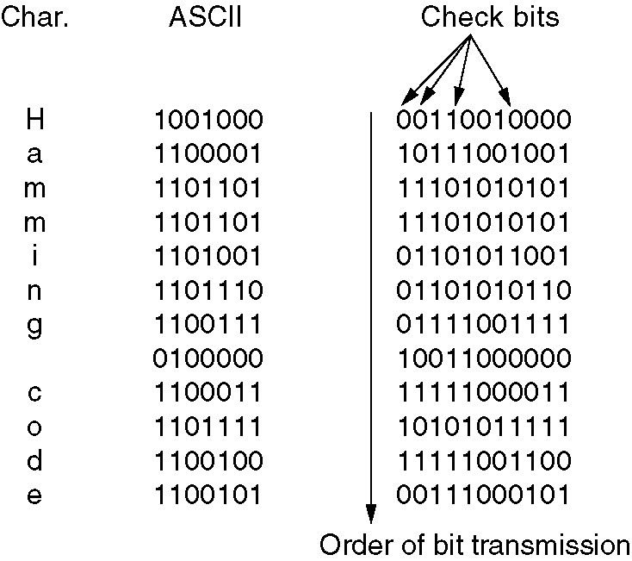
Error correcting codes:
Use of a Hamming code to correct burst errors.

Slide 69
Frame header of Data link layer
packet
network layer
buffer
frame
info
ack
seq
kind
data link layer

Slide 70

Flow and Error Control
Data link control = flow control + error control
Flow control refers to a set of procedures used to restrict the amount of data that the sender can send before waiting for acknowledgement
Error control in the data link layer is based on automatic repeat request (ARQ), which is the retransmission of data
ACK, NAK(Negative ACK), Piggybacking (ACKs and NAKs in data frames)

Slide 71
Elementary Data link Protocols:
Protocols:
  1) unrestricted simplex protocol
  2) A simplex stop-and-wait protocol
  3) A simplex protocol for a Noisy Channel

Slide 72
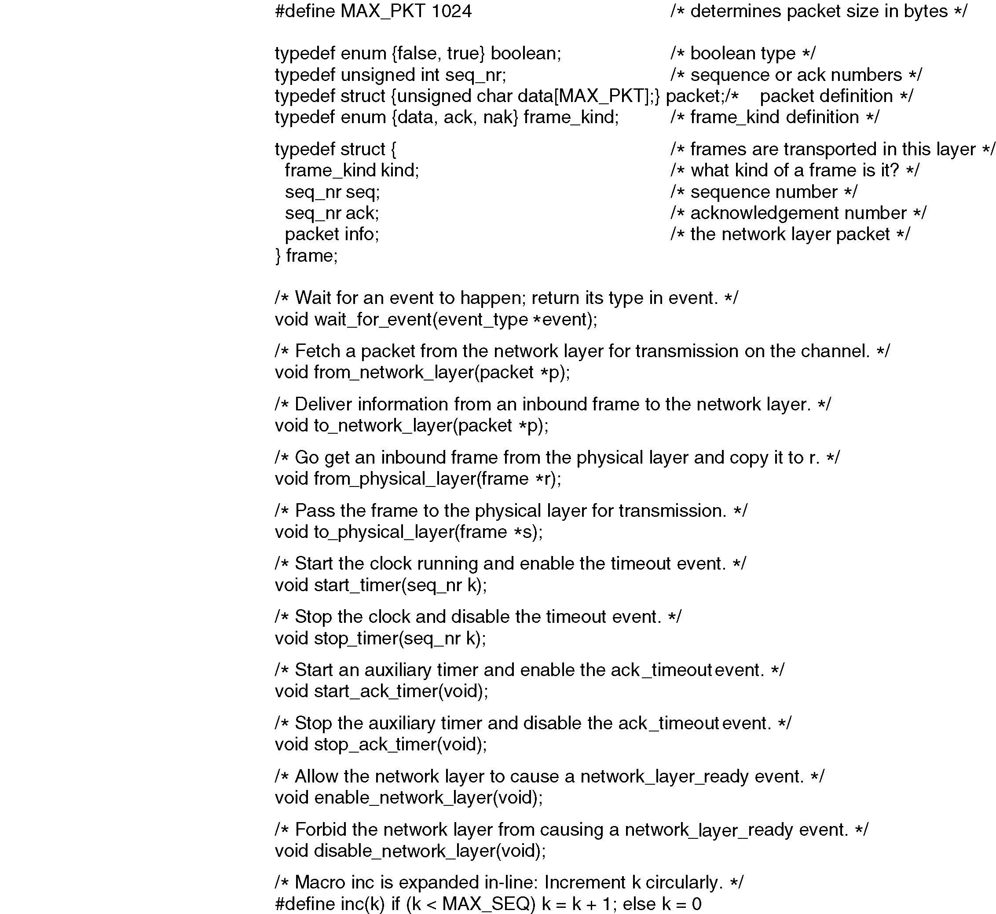
Protocol Definitions
Continued →
Some definitions needed in the protocols to follow. These are located in the file protocol.h.

Slide 73
Protocol
Definitions
(ctd.)
Some definitions needed in the protocols to follow. These are located in the file protocol.h.

Slide 74
unrestricted simplex protocol
Data are transmitted in one direction only.
Both the transmitting and receiving network layers are always ready
processing time can be ignored
Infinite buffer space is available
The protocol consists of two distinct procedures, a sender and a receiver. The sender runs in the data link layer of the source machine and the receiver runs in the data link layer of the destination machine.
MAX-SEQ is not used because No sequence numbers and Acknowledgements are used here.
The only event type possible is frame-arrival (i.e. an arrival of undamaged frame)

Slide 75

Noiseless Channels: Simplest Protocol
Simplest protocol with no flow or error control

Slide 76

Flow diagram for Noiseless Channels: Simplest Protocol
11.<number>

Slide 77
A simplex stop-and-wait protocol:
If data frames arrives at the receiver side faster than they can be processed, the frames must be stored until their use
Normally ,the receiver does not have enough storage space ,especially if it is receiving data from many sources
This may result in the discarding frames
To prevent this there must be feedback from the receiver to the sender.

Slide 78
A simplex stop-and-wait protocol:
Def : Protocol in which the sender sends one frame and then waits for acknowledgement before proceeding is called stop-and-wait.
Flow Diagram:
A
B
Request
Frame
Arrival
Ack
Arrival
Frame
Request
Ack
Arrival

Slide 79

Stop-and-Wait Protocol
Simple tokens of ACK and flow control added

Slide 80

Stop-and-Wait Protocol: Example

Slide 81
A simplex stop-and-wait protocol:
Receiver 2 is that after delivering a packet to the network layer, receiver 2 sends an acknowledgement frame back to the sender before entering the wait loop again. because the only arrival of the frame back at the sender is important. the receiver need not put any particular information on it.
points:
  1) sender start out fetching a packet from the network layer, using it to construct a frame and sending it on its way.
  2)sender must wait until an acknowledgement frame arrives before looping back and fetching the next packet from the network layer

Slide 82
A simplex protocol for a Noisy Channel
The channel is noisy, frames may be damaged or lost
Good scene : data frame reaches intact, ack sent back and received, next frame sent
Bad scene :
  Data frame damaged or lost ..hence no ack – sender times out and resends .. No problems
  Data frame reaches intact but Ack lost .. Times out ..resends.. Receiver receives duplicate frames. Problem
  Solution :Keep a sequence number for each frame to distinguish between the new frame and a duplicate frame

Slide 83
A simplex protocol for a Noisy Channel
What should be minimum number of bits required for the sequence number?
  The only ambiguity in this protocol is between a frame,m.and its direct successor,m+1.If a frame m is lost or damaged ,the receiver will not acknowledge it ,so the sender will keep trying to send it. Once it has been correctly received ,the receiver will send an ack back to the sender. Depending upon whether the acknowledgement frame gets back to the sender correctly or not ,the sender may try to send m or m+1.the event triggers the sender to start sending m+2 is the arrival of an acknowledgement m+1.
  Protocols in which the sender waits for a positive acknowledgement before advancing to the next data item are often called (PAR-Positive acknowledgement retransmission or ARQ- Automatic Repeat Request)

Slide 84
Noisy Channels: Stop-and-Wait ARQ
Stop-and-wait Automatic Repeat Request (ARQ)
Error correction in Stop-and-Wait ARQ is done by keeping a copy of the sent frame and retransmitting of the frame when the timer expires
In Stop-and-Wait ARQ, we use sequence numbers to number the frames. The sequence numbers are based on modulo-2 arithmetic
Acknowledgment number always announces in modulo-2 arithmetic the sequence number of the next frame expected.

Slide 85

Stop-and-Wait ARQ

Slide 86

Stop-and-Wait ARQ: Example

Slide 87
Contd..
The Stop-and-Wait ARQ is very inefficient if our channel has a large bandwidth and long round-trip delay.
There is no Pipelining in this protocol because we need to wait for a frame to reach the destination and be acknowledged before the next frame is sent.

Slide 88
Sliding window protocols
Must be able to transmit data in both directions.
Choices for utilization of the reverse channel:
  mix DATA frames with ACK frames.
  Piggyback the ACK
    Receiver waits for DATA traffic in the opposite direction.
    Use the ACK field in the frame header to send sequence number of frame being ACKed.
  ➔ better use of the channel capacity.

Slide 89
Sliding window protocols:
In the Previous protocols ,Data frames were transmitted in one direction only.
In most practical situations ,there is a need for transmitting data in both directions.
One way of achieving full-duplex data transmission is to have two separate communication channels and each one for simplex data traffic (in different directions)
we have two separate physical circuits ,each with a “forward” channel (for data) and a “reverse” channel( for acknowledgements).
Data
source
Acknowledgements
Destination

Slide 90
Sliding window protocols:
Disadvantage: The bandwidth of the reverse channel is almost entirely wasted.
A better idea is to use the same circuits for data in both directions
In this model the data frames from A and B are intermixed with the acknowledgement frames from A to B.
Kind: kind field in the header of an incoming frame, the receiver can tell whether the frame is data or acknowledgements.

Slide 91
Sliding window protocols:
Piggybacking:
Frame sent(Frame1)
source
Destination
Ack(frame1)+Frame2
When a data frame arrives, instead of immediately sending a separate control frame, the receiver restrains itself and waits until the network layer passes it the next packet.
The acknowledgement is attached to the outgoing data frame
Disadv: This technique is temporarily delaying outgoing acknowledgements.
If the datalinklayer waits longer than the senders timeout period, the frame will be retransmitted.

Slide 92
Sliding window protocols:
Rule: sender waiting a fixed number of milliseconds. If a new packet arrives quickly the acknowledgement is piggybacked onto it. other wise if no new packet has arrived by the end of this time period ,the data link layer just sends a separate acknowledgement frame.
In sliding window protocol each frame contains a sequence number ranging from 0 up to some maximum.
The maximum is usually 2^{n}-1 so the sequence number fits nicely in an n-bit field.
The stop-and-wait sliding window protocol uses n=1 restricting the sequence numbers 0 and 1.
The sender must keep all these frames in its memory for possible retransmission

Slide 93
Sliding window protocols:
Thus if the maximum window size is n, the sender needs n buffers to hold the unacknowledged frames
3 bit field -000
001
010..etc
here n=3 i.e. 2³-1=7
window size is 0 to 7
Sliding window :: sender has a window of frames and maintains a list of consecutive sequence numbers for frames that it is permitted to send without waiting for ACKs.
receiver has a window that is a list of frame sequence numbers it is permitted to accept.
Note – sending and receiving windows do NOT have to be the same
size.

Slide 94
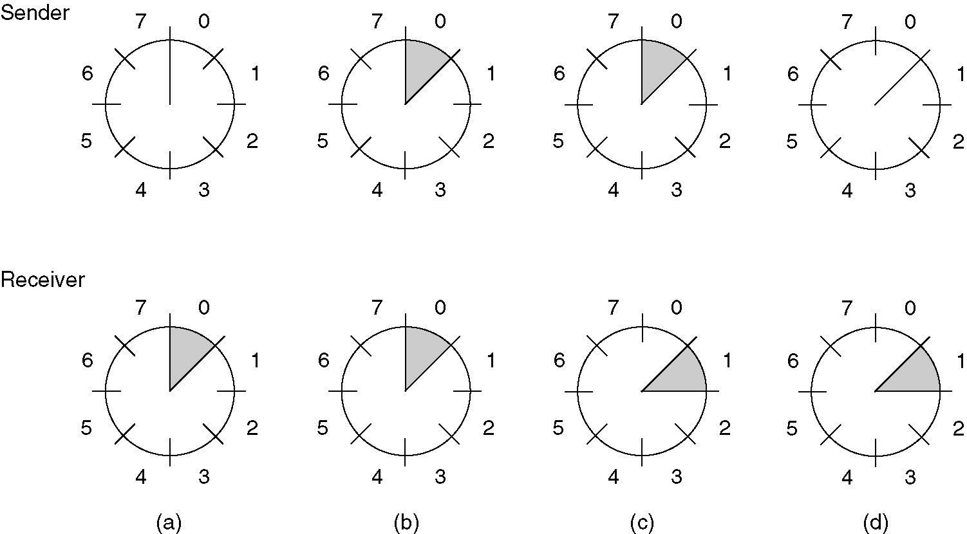
Sliding window protocols:
A sliding window of size 1, with a 3-bit sequence number.
(a) Initially.
(b) After the first frame has been sent.
(c) After the first frame has been received.
(d) After the first acknowledgement has been received.

Slide 95
Sliding window protocols:
Sliding window protocols: 3 methods
  1) 1-bit sliding window protocol
  2) Go –Back N
  3) Selective Repeat
1-bit sliding window protocol:
  Window size 1.
  Stop-and-wait.
  Must get ack before can send next frame.
  Both machines are sending and receiving.

Slide 96
A protocol using Go Back N:
Go Back n, is for the receiver simply to discard all subsequent frames, sending no acknowledgements for the discarded frames. This strategy corresponds to a receive window of size 1.
The data link layer refuses to accept any frame except the next one it must give to the network layer.
Points: fig ( a)
1) frame 0 and 1 correctly received and Acknowledged
2) Frame 2 is damaged or lost ,The sender continuous to send frames until the timer for frame 2 expires.
3) Then it backs up to frame 2 and starts all over with it ,sending 2,3,4 etc. all over again.

Slide 97
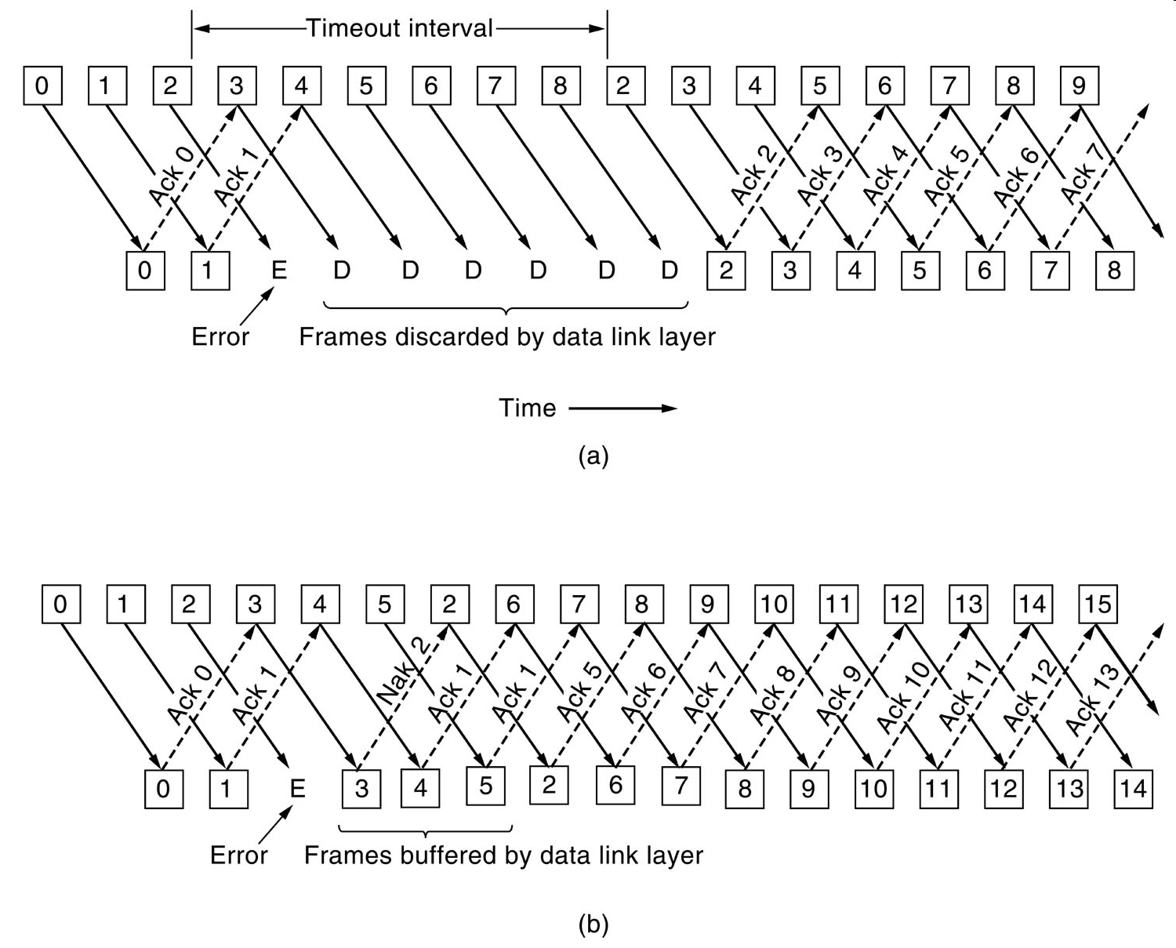
A protocol using Go Back N:

Slide 98

Go-Back-N ARQ
Pipelining improves the efficiency of the transmission
In the Go-Back-N Protocol, the sequence numbers are modulo 2^{m}, where m is the size of the sequence number field in bits
The send window is an abstract concept defining an imaginary box of size 2^{m} − 1 with three variables: S_{f}, S_{n}, and S_{size}
The send window can slide one or more slots when a valid acknowledgment arrives.

Slide 99

Go-Back-N ARQ
Receive window for Go-Back-N ARQ
The receive window is an abstract concept defining an imaginary box of size 1 with one single variable R_{n}. The window slides when a correct frame has arrived; sliding occurs one slot at a time.

Slide 100
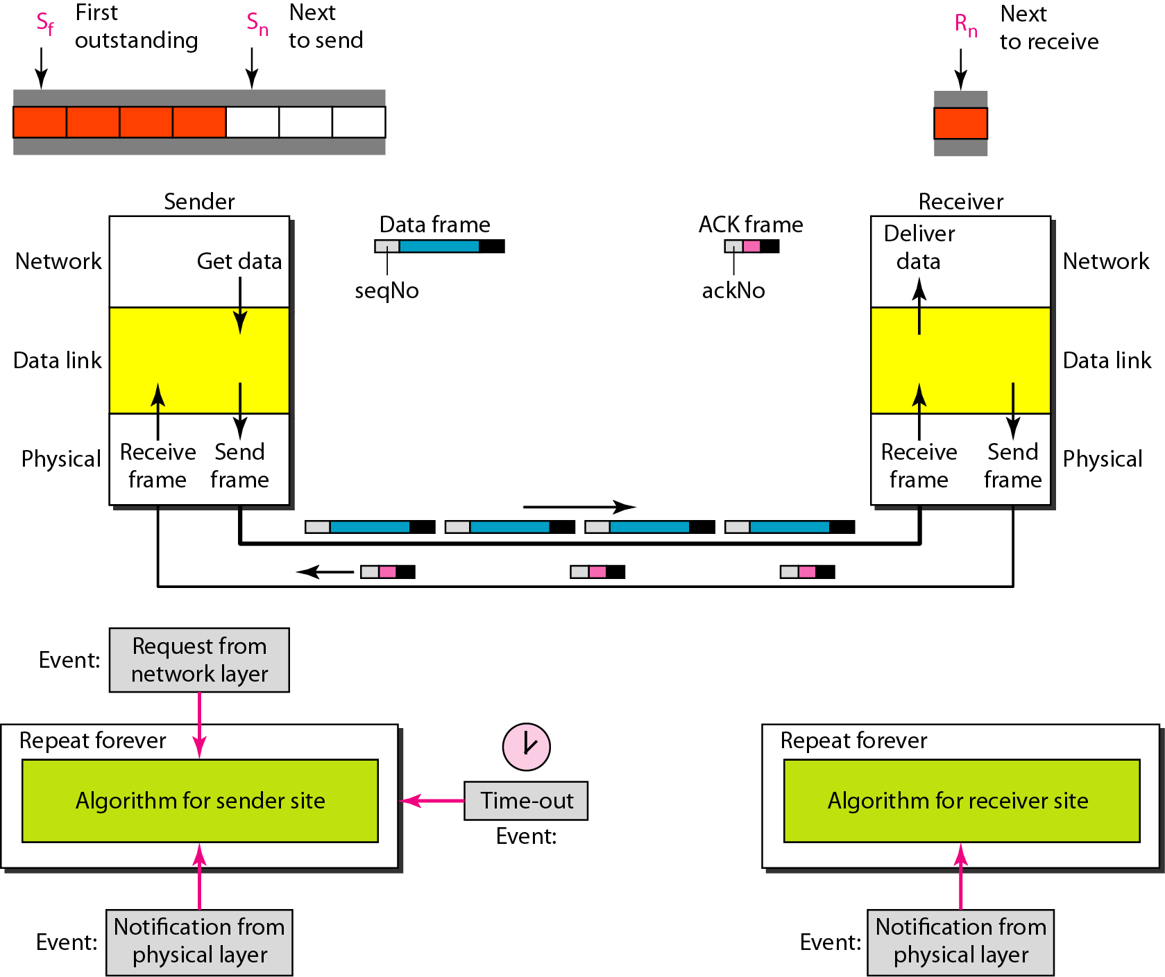
Go-Back-N ARQ
Sliding windows, Timers, ACK, Resending a frame

Slide 101

Go-Back-N ARQ: Send Window Size
In Go-Back-N ARQ, the size of the send window must be less than 2^{m}; the size of the receiver window is always 1
Stop-and-Wait ARQ is a special case of Go-Back-N ARQ in which the size of the send window is 1

Slide 102

Go-Back-N ARQ: Example 1

Slide 103

Go-Back-N ARQ: Example 2

Slide 104
Selective Repeat:
When selective repeat is used ,a bad frame that is received is discarded. But good frames after it are buffered.
when the senders timeout ,only the oldest unacknowledged frame is retransmitted.
If that frames arrives correctly ,the receiver can deliver it to the network layer in sequence all the frames it has buffered.
fig (b) :
  1) Frames 0 and 1 correctly received and acknowledged.
  2) Frame 2 is lost, when frame 3 arrives at the receiver ,the data link layer notices that it has a missed frame. so it sends back a NAK for 2 but buffers 3
  3) when frame 4 and 5 arrive ,they are buffered by the data link layer instead of being passed to the network layer
  4)The NAK 2 gets back to the sender which immediately resends frame 2.

Slide 105
A protocol using selective repeat:

Slide 106


Selective Repeat ARQ
Sender window size
Receive window size

Slide 107
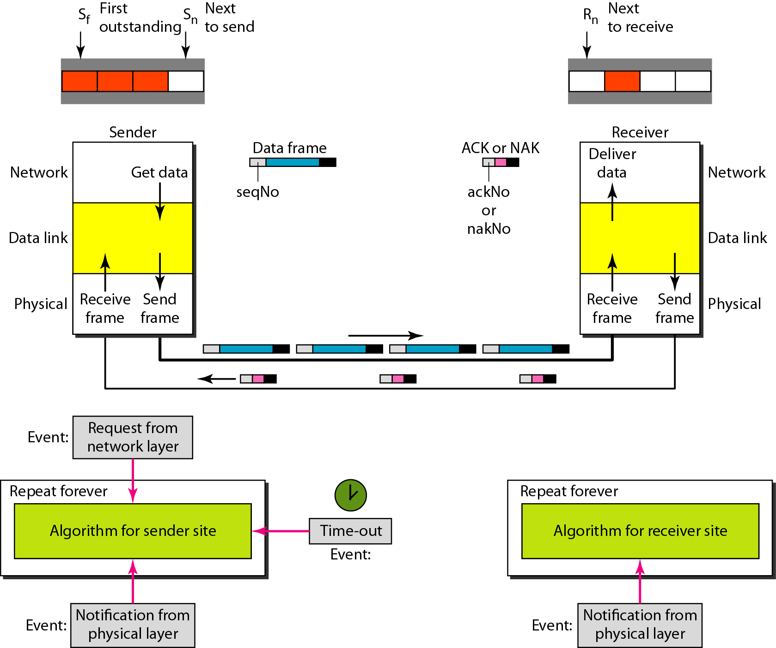
Selective Repeat ARQ

Slide 108

Selective Repeat ARQ: Window Size
The size of the sender and receiver window must be at most one-half of 2^{m}

Slide 109
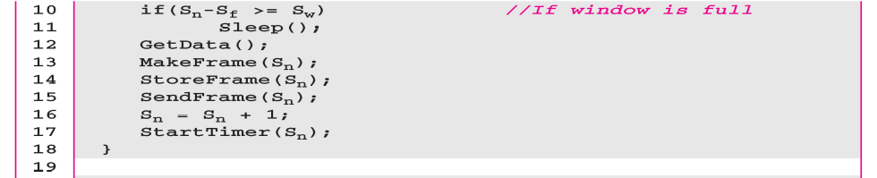
Selective Repeat ARQ: Sender-Site Algorithm

Slide 110
Selective Repeat ARQ: Receiver-Site Algorithm

Slide 111

Selective Repeat ARQ: Example

Slide 112
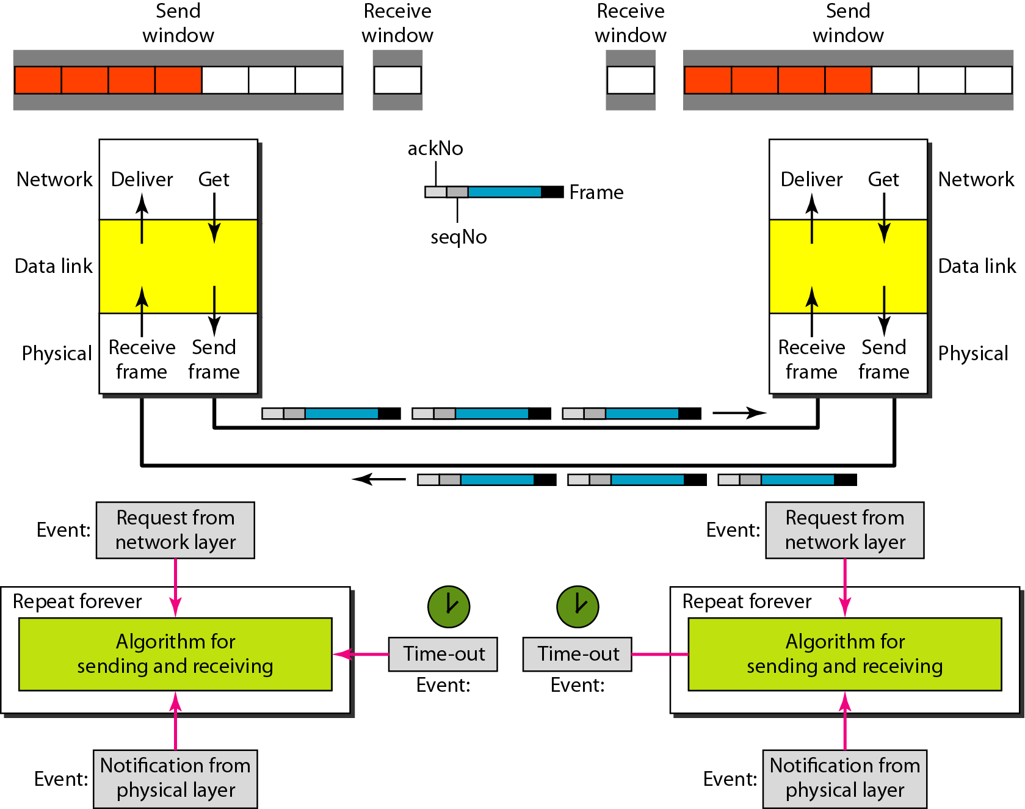
Piggybacking
To improve the efficiency of the bidirectional protocols
Piggybacking in Go-Back-N ARQ

Slide 113
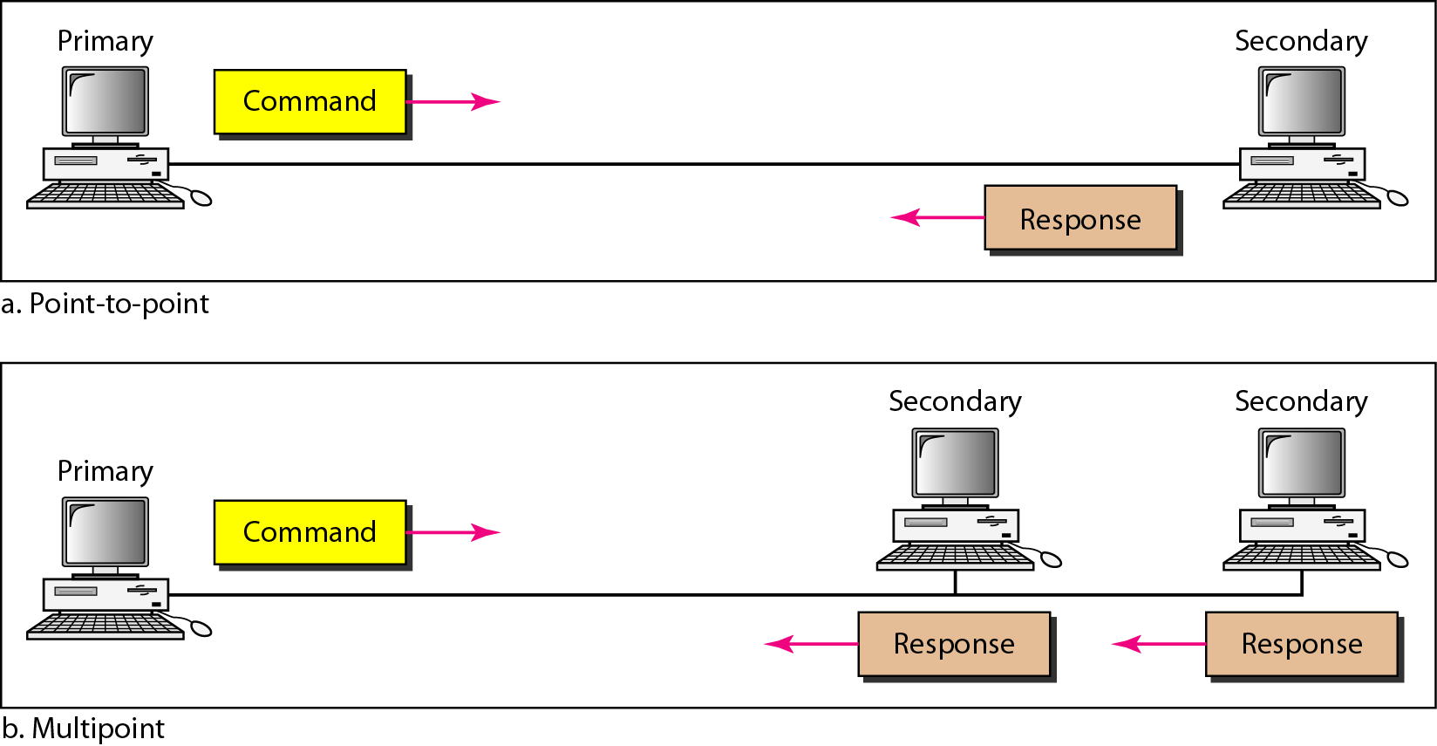
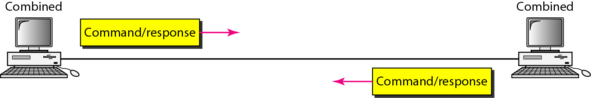
HDLC
High-level Data Link Control is a bit-oriented protocol for communication over point-to-point and multipoint links.
Two common transfer mode: normal response mode (NRM) and asynchronous balanced mode (ABM)
NRM
ABM

Slide 114
FRAMES
To provide the flexibility necessary to support all the options possible in the modes and configuration, HDLC defines three types of frames:
Information frames(I-frame)
Supervisory frames(S-frames)
Unnumbered frames(U-frames)

Slide 115
I-frames are used to transport user data and the control information relating to user data(Piggybacking).
S-frames are used only to transport control information.
U-frames are reserved for system management. The information carried by U-frame is intended for managing the link itself.

Slide 116
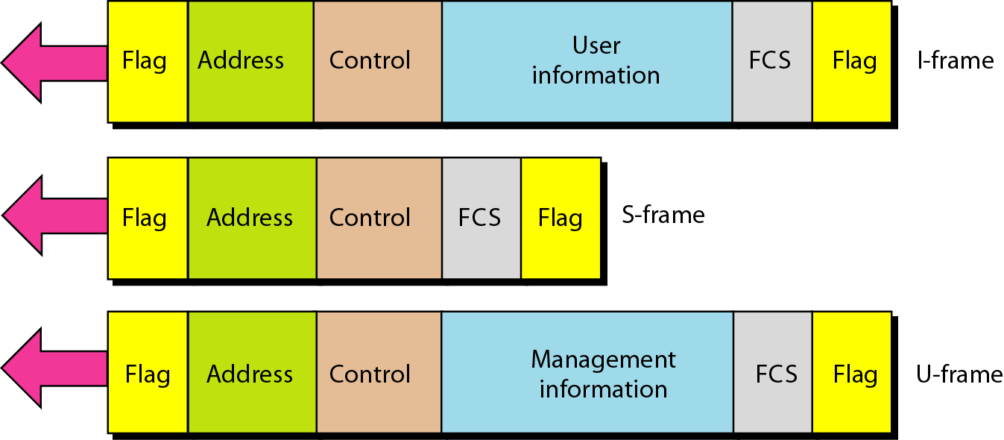
HDLC frames:

Slide 117
HDLC: Frames
Flag field: 01111110 to identify both the beginning and the end of a frame and serve as synchronization pattern for receiver.
Address: contains address of secondary station. If a primary station created the frame, it contains a to address. If secondary creates the frame, it contains a from address(1 byte or several bytes long).
Control field: 1-or 2-bytes segment used for flow and error control (interpretation depends on the frame type).
Information field: contains the user’s data from the network layer or management information(its length vary from one network to another)
FCS field: Forward Check Sequence is 2- or 4-byte ITU-T CRC for error detection

Slide 118
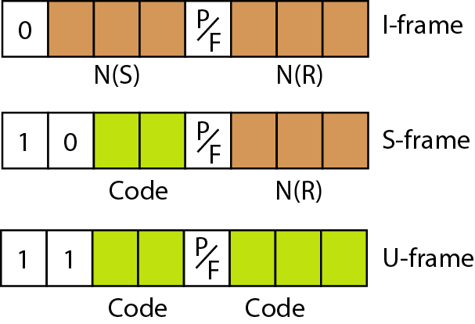
Control Field
Control Field: 1- or 2-byte segment of the frame used for flow and error control
Determine the type of frame and define its functionality
Control field for I-frame: P/F (poll/final bit for primary/secondary)

Slide 119
HDLC: Frames
Control field for I-frame
Carry user data from network layer.
Include flow and error control
The first bit defines the type. If the first bit of control field is 0, this means it is I-frame.
N(S) defines a sequence number of the frame. As it is three bits we can define sequence no between 0 and 7
N(R) correspond to the acknowledgment number when piggybacking is used.
P/F is for dual purpose. If it set to 1, it can mean either poll or final.
It means poll when the frame is sent by a primary station to secondary.
It means Final when frame is sent by a secondary to primary.

Slide 120
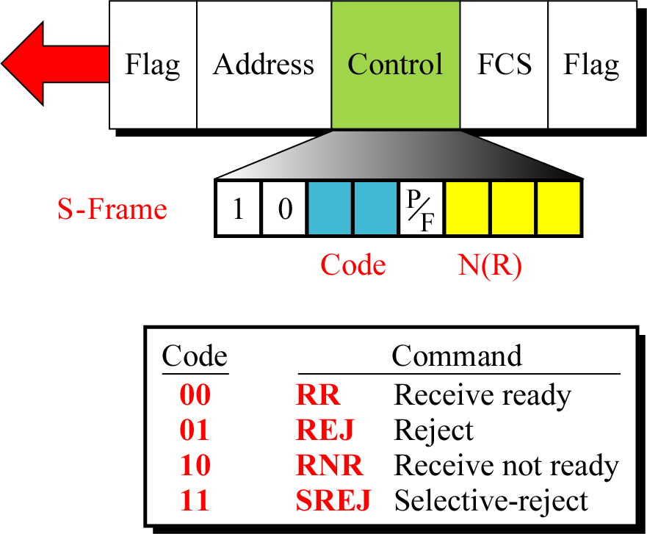
HDLC: Frames
Control field for S-frame
Used for flow and error control whenever piggybacking is either impossible or inappropriate
Receive ready (RR), Receive not ready (RNR), Reject (REJ) Selective reject (SREJ)

Slide 121
HDLC: Frames
Control field for U-frame(exchange session management & control information between connected devices).
Contains information field, but one used for system management, not user data.
U-frames are divided into two sections: a 2-bit prefix before the P/F bit and a 3-bit suffix after P/F bit.

Slide 122
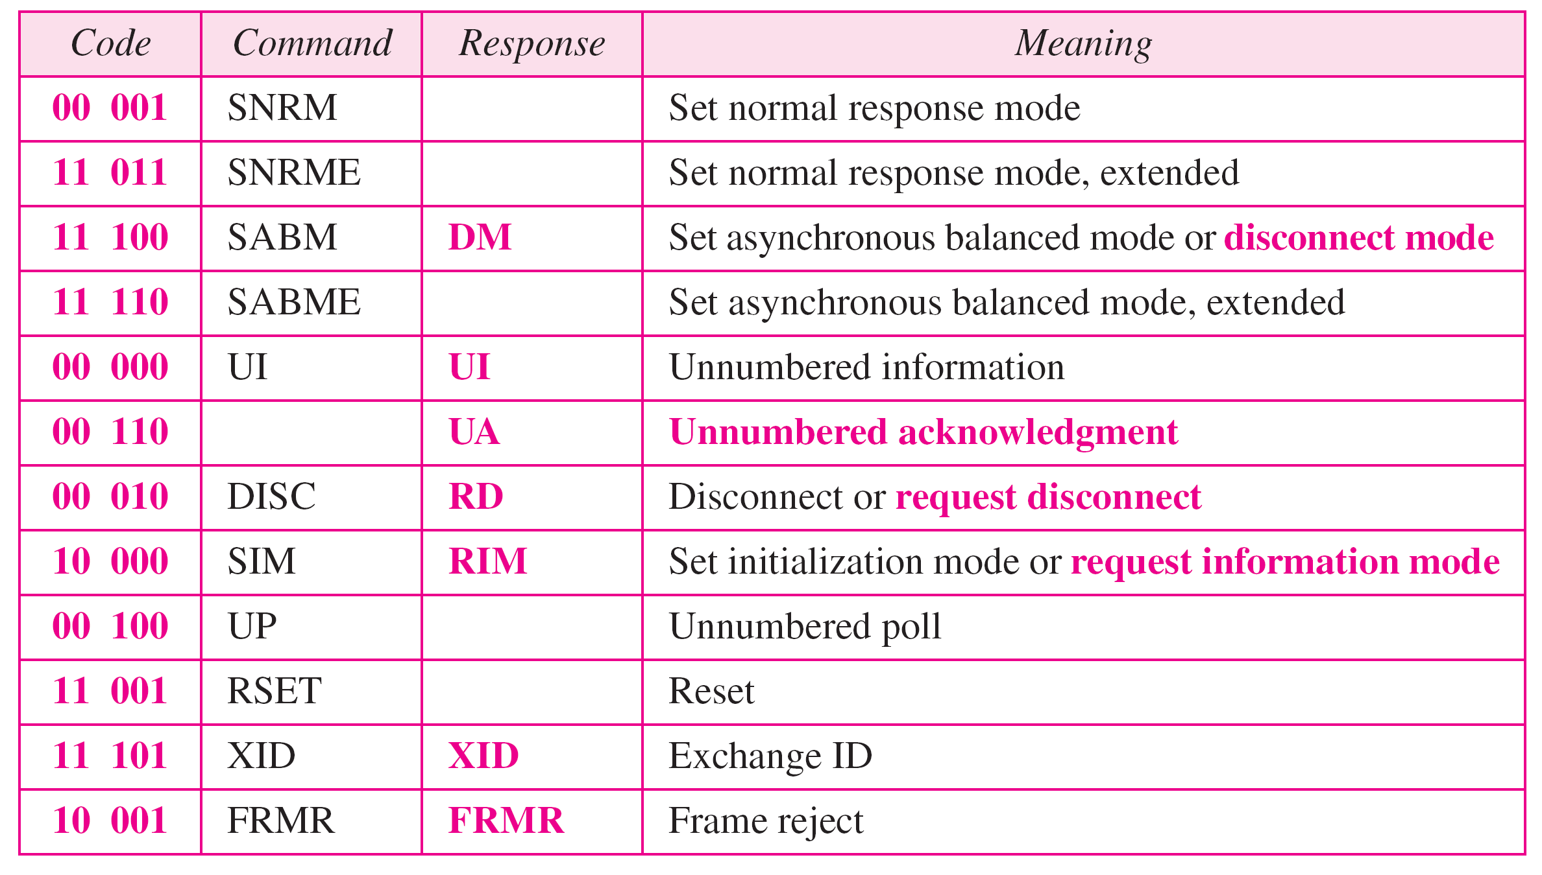
HDLC: Frames

Slide 123
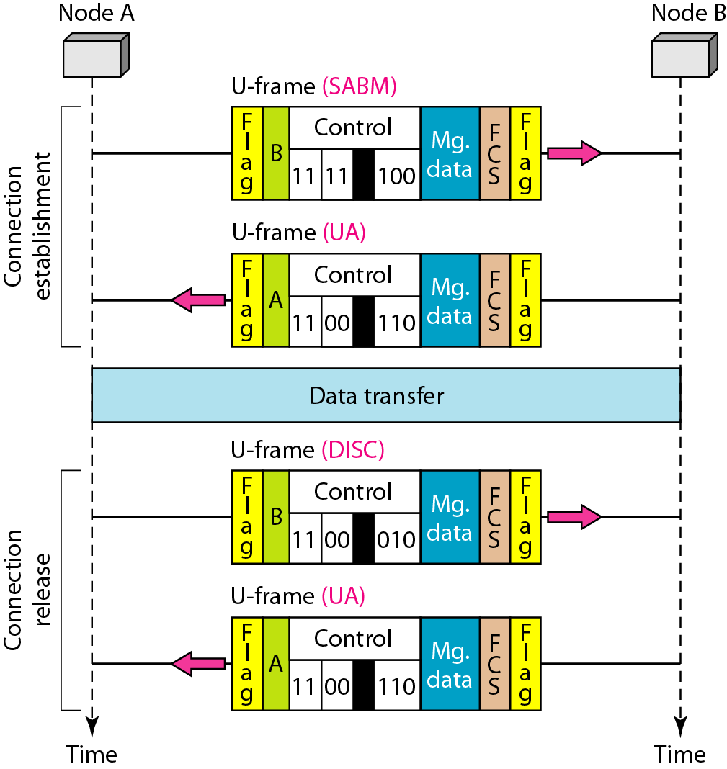
HDLC: Example 1
Connection and disconnection

Slide 124
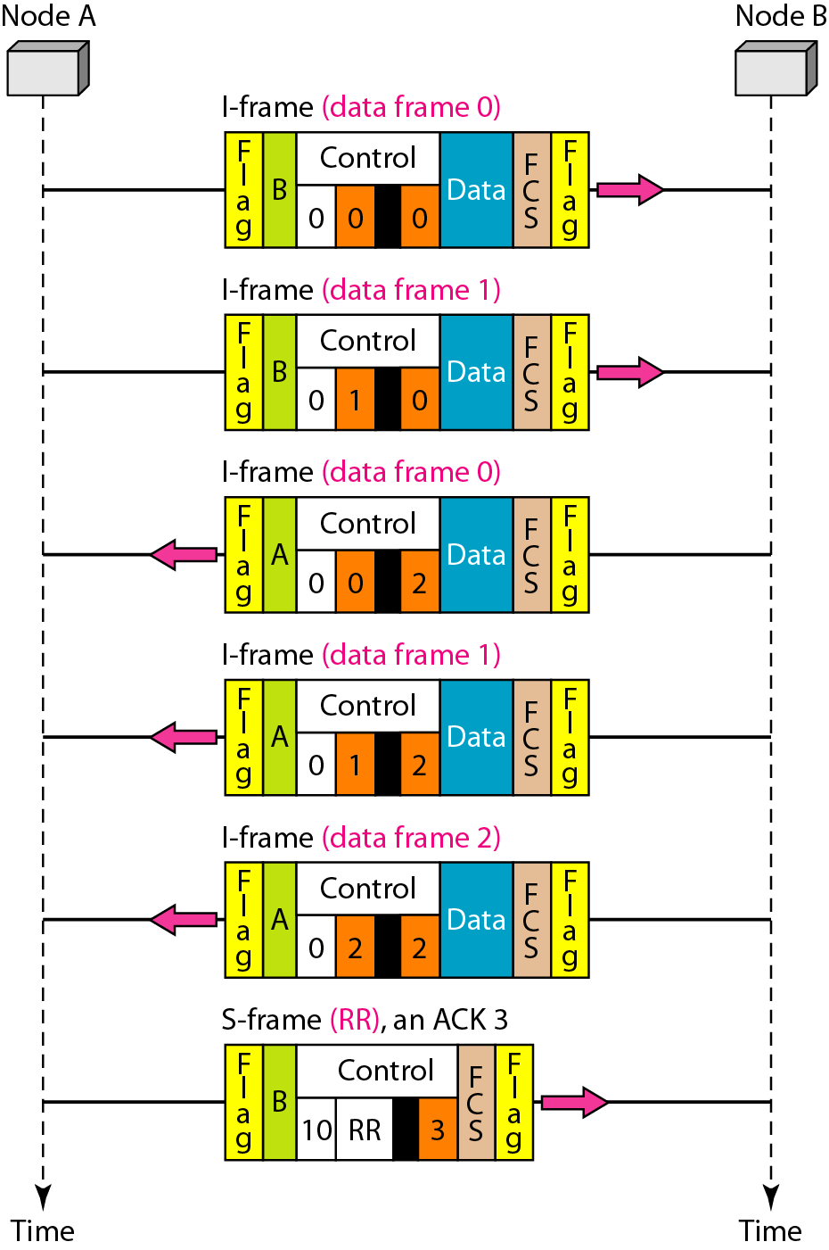
HDLC: Example 2
Piggybacking without error

Slide 125
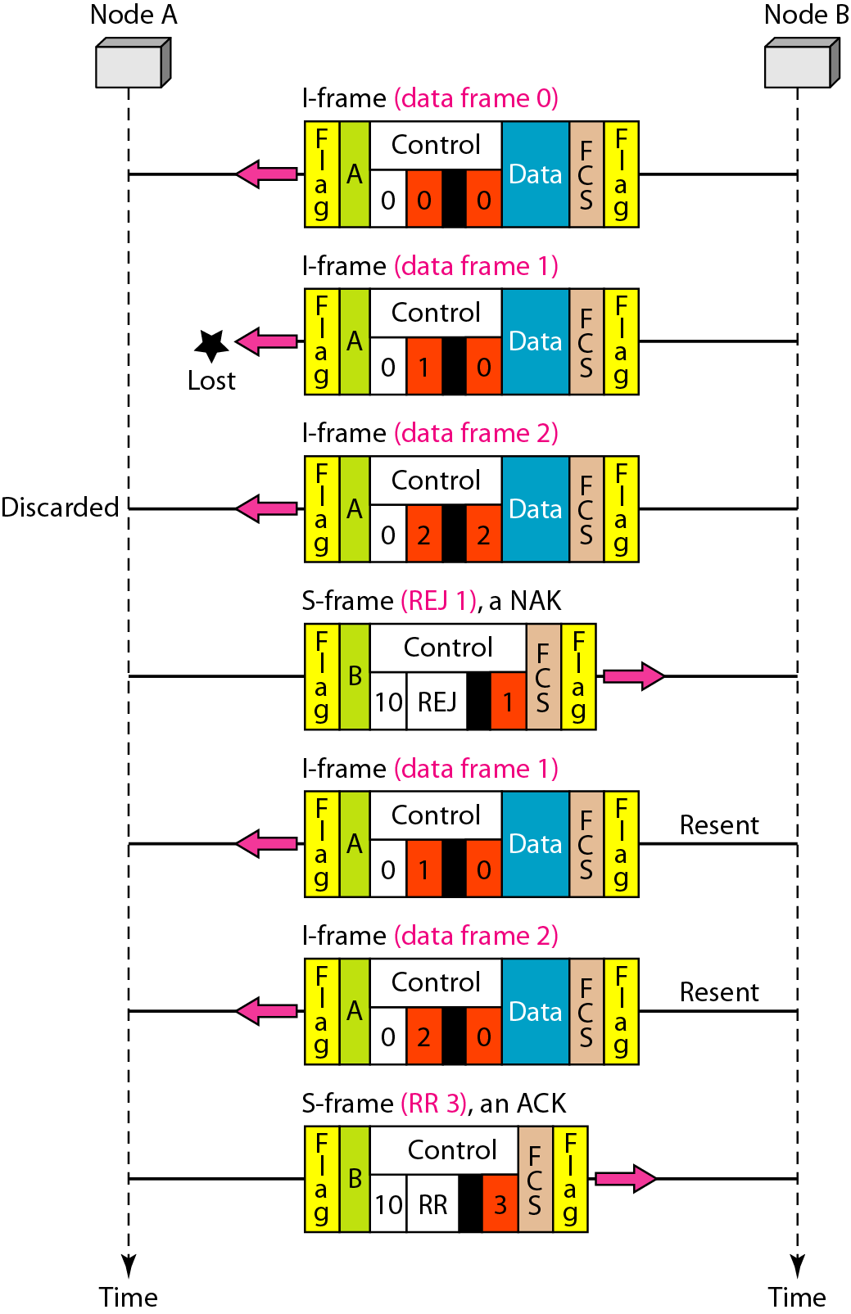
HDLC: Example 3
Piggybacking with error

Slide 126
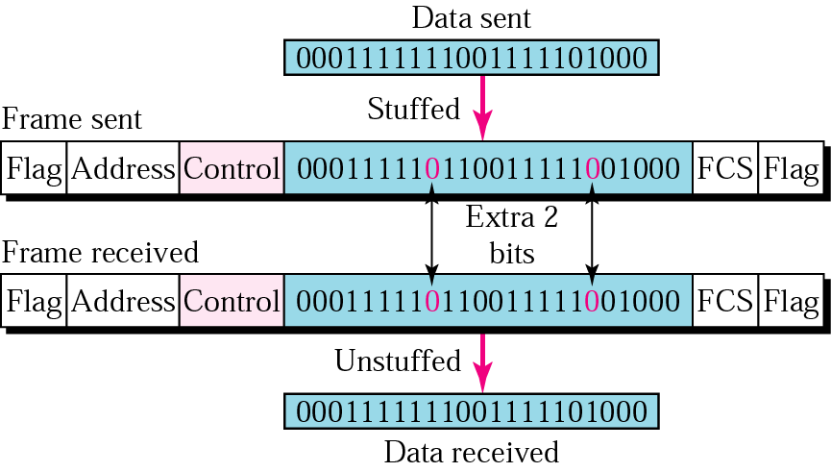
HDLC: Bit Stuffing and Unstuffing

Slide 127
Example Data Link Protocols:
The Data Link Layer in the Internet - LANs use broadcast protocols (Ethernet) to connect many hosts but interconnection of LANs into larger networks is primary done through routers running a point-to-point protocol. In the case of the Internet, point-to-point protocol is also used to connect host to router in the form of an Internet Service Provider. Two point-to-point protocols widely used on the Internet are SLIP and PPP.
SLIP – Serial Line Internet Protocol- Designed to connect hosts to the internet over serial communications.

Slide 128
SLIP – Serial Line Internet Protocol
Designed to connect hosts to the Internet over serial communications.
Send raw IP packets over serial (possibly modem) line with C0 hex at end for framing, if occurs in IP packet uses character stuffing.
Recent versions use TCP and IP header compression by omitting when multiple packets going to same destination.
No error detection/correction, responsibility of higher layers.
Supports only IP.
No authentication (though could be handled by higher layers).
Fixed IPs, both must know each others in advance (not a problem if yours and ISP never change).

Slide 129
Drawbacks of SLIP
SLIP does not do error detection and correction
SLIP supports only IP
Each side must know others IP address in advance
SLIP does not provide any form of authentication
SLIP is not approved as internet standard

Slide 130
PPP - Point-to-Point Protocol
Fixes many of SLIPs problems and is an official Internet protocol
Used in Dial-up connection between residential host and ISP
Framing
Byte stuffing
Connection oriented
Error detection by checksum.
Permits authentication.
LCP: It is responsible for establishing the connection and releasing the connection
NCP: Network Control Protocol – It provides all the services of Network layer

Slide 131
Overcomes all deficiencies of SLIP.
  A better framing method.
  Frame format supports error detection.
  Provide with a Link Control protocol (LCP), for bringing lines up, testing them, negotiating options, and bringing then down back.
  Have different NCP (Network Control Protocol) for each different network protocol.

Slide 132
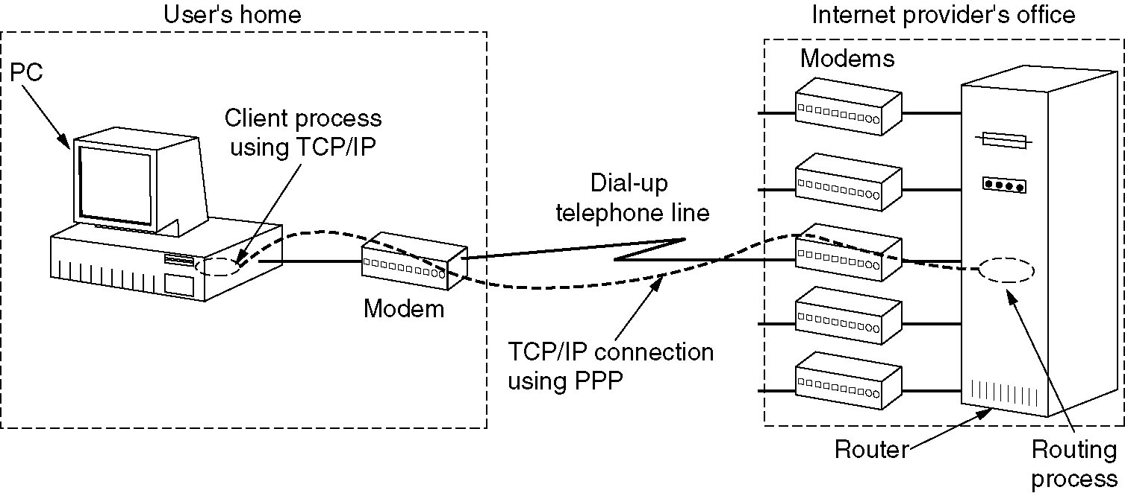
The Data Link Layer in the Internet
A home personal computer acting as an internet host.
A home personal computer acting as an internet host.

Slide 133
PPP operation
PC calls the provider’s router via a modem.
After establishment of the connection PC sends a series of LCP packets.
Then a series of NCP packets are sent to configure the network layer.
Now PC is ready to send and receive IP packets.
After finishing again NCP packets are sent to tear down the network layer connections.
Finally LCP packets are used to shutdown the connection.
PC releases the physical connection via the modem.

Slide 134
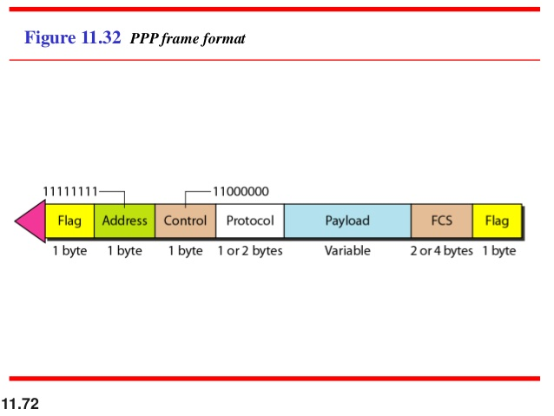
PPP - Point-to-Point Protocol

Slide 135
Flag: A PPP frame starts and ends with a 1-byte flag with the bit pattern 01111110.It is a byte-oriented protocol. The flag is treated as a byte.
Address: It is a constant value and is set to 11111111(broadcast address).During negotiation, the two parties may agree to omit this byte.
Control:11000000(imitating U-frame in HDLC).PPP does not provide any flow control. Error control is also limited to error detection.
Protocol: It defines what is being carried in the data field: either user data or other information.
Payload field: It carries either the user data or other information. The default of max..1500 bytes.
FCS: 2-bytes or 4-bytes standard CRC.

Slide 136
Byte Stuffing:
PPP is a byte oriented protocol.
The flag in PPP is a byte and needs to be escaped whenever it appears in the data section of the frame.
The esc byte is 01111101,means that every time the flag like pattern appears in the data, this extra byte is stuffed to tell the receiver that the next byte is not a flag.

Slide 137
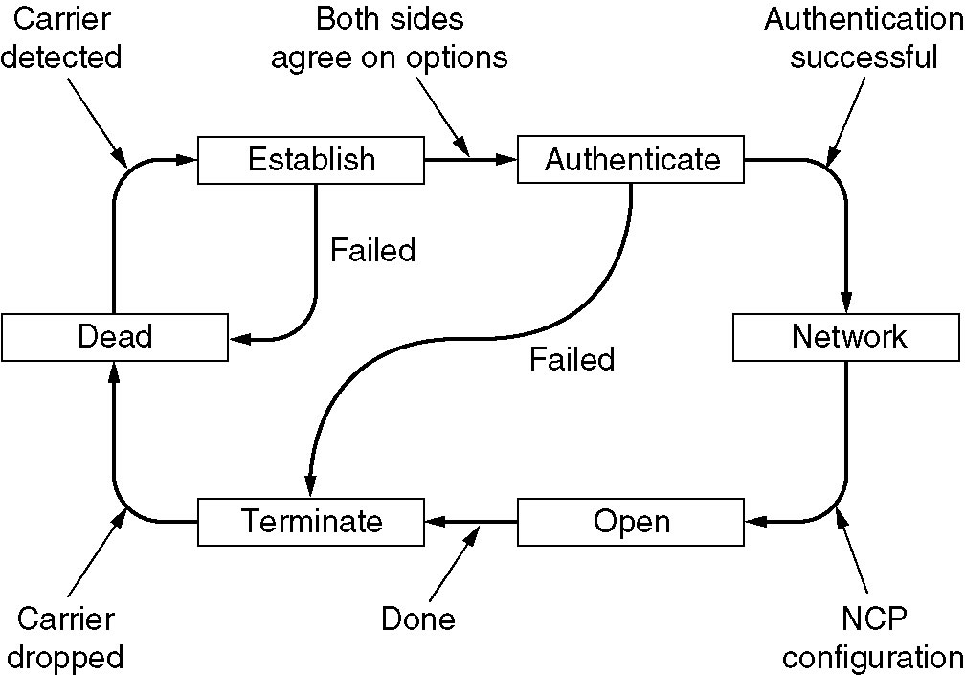
PPP – Point to Point Protocol
A simplified phase diagram for bring a line up and down.

Slide 138
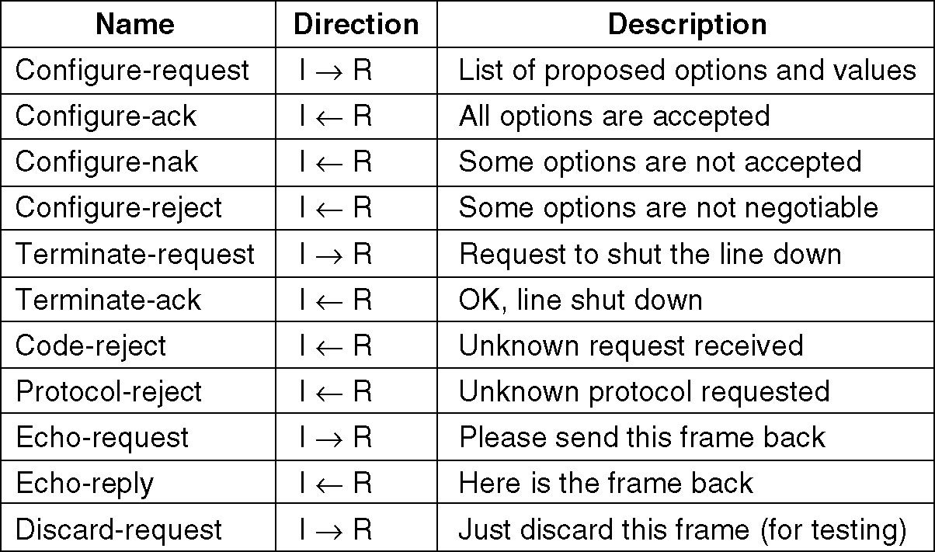
PPP – Point to Point Protocol
The LCP frame types.

